Slide 1


Name:- Patel Dev Mayank Kumar
Branch:- CE
Batch / Div:-A5
Enrollment No:-23002170110116
Roll No:- 147
Subject:- FSD-1
Project Title:- Ott Platform

Slide 2


Car Gemini: Your Automotive Companion
Welcome to Car Gemini, your comprehensive resource for all things automotive.
Notes:
1

Slide 3
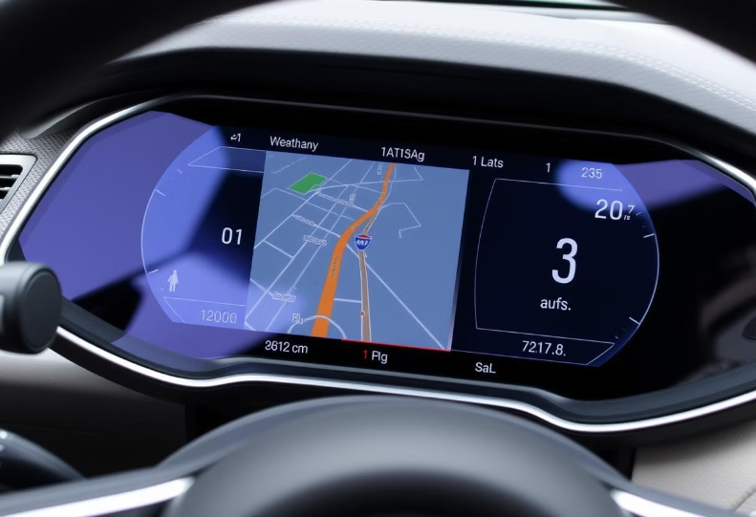
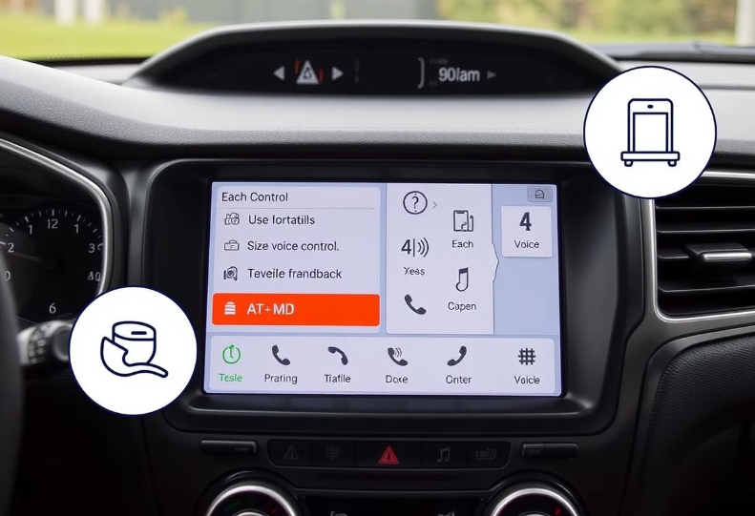
Our Mission: Simplifying Car Information
Clear
Accessible
My mission is to provide clear and concise car information, eliminating confusion.
I make car information accessible to everyone, regardless of their automotive expertise.
Notes:
2

Slide 4

Detailed Car Descriptions and Specifications
Features
Images
Video
My detailed descriptions include everything from engine specs to safety features.
I provide high-quality images and videos to help you visualize the car.
I give video for how look user car in real world.
Notes:
3

Slide 5

User-Friendly Navigation and Search Features
My site is designed for ease of use.
Not a complex design
1
2
My site is designed for user so they can get information about easily
3
Notes:
4

Slide 6

Tools:
HTML
JAVA Script
1
2
CSS
Bootstrp 4,5
3
2
Notes:
5

Slide 7
Future Scope: Expanding Our Automotive Expertise
1
Dealer Network
2
Car Financing
3
Community Forum
Connect with local dealerships and get personalized offers.
Compare loan options and find the best financing rates.
Connect with other car enthusiasts and share your knowledge.
Notes:
6

Slide 8

Thank You!
We appreciate you taking the time to learn about Car Gemini. We hope you find our platform helpful in your car search and decision-making process. Safe travels!
Notes:
7

